Slide 1
TCP

Slide 2
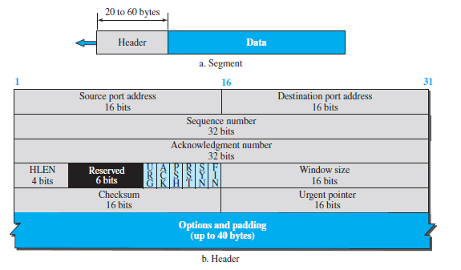
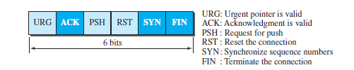
TCP SEGMENT

Slide 3
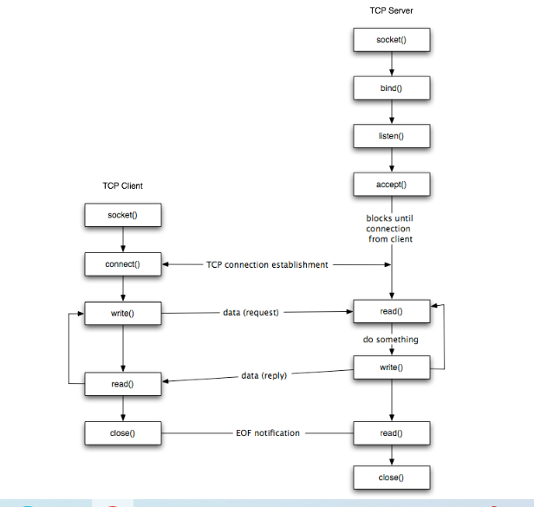
TCP SOCKET PROGRAMMING

Slide 4
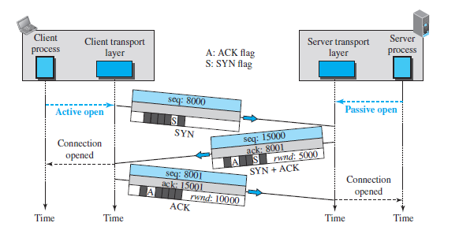
Connection establishment using three-way handshaking

Slide 5
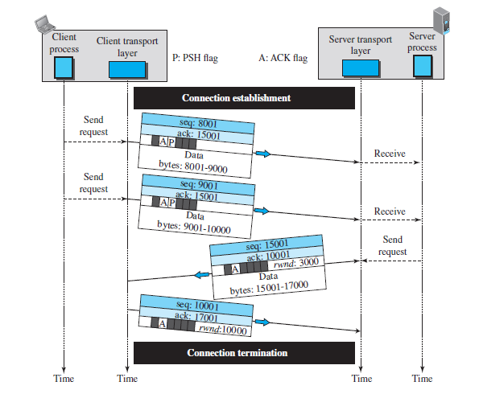
DATA TRANSFER

Slide 6
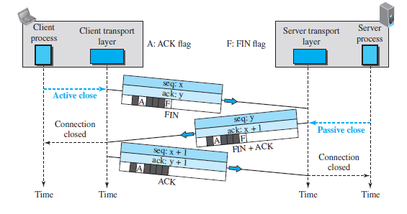
CONNECTION TERMINATION

Slide 7
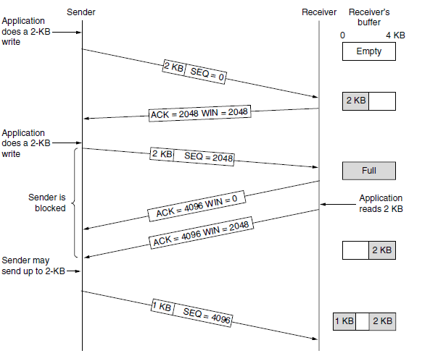
Window management in TCP

Slide 8
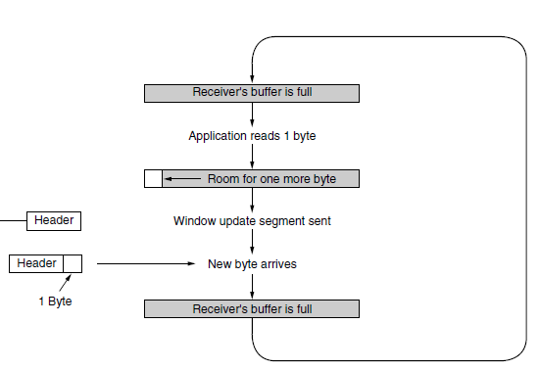
silly Window Syndrome

Slide 9
TCP TIMERS
RETRANSMISSION TIMER –For Retransmission of Packets
PERSISTENCE TIMER- For window size enquiry
KEEPALIVE TIMER- checking the liveness for continuing the connection

